Slide 1
Hydrologic Conditions: Surface and Ground Water Resources September 2012
Notes:
The DNR summarizes the climatic, surface and groundwater resources on a monthly basis using information from a variety of sources.

Slide 2
2011 2012
Notes:
About two dozen observation wells across the state are used as indicators of the regional ground water levels

Slide 3
2011 2012
Notes:
Two dozen lakes across the state are used as indicators of the regional lake water levels

Slide 4
2011 2012
Notes:
Stream flow conditions are based on USGS and DNR watershed indicator gages across the state.

Slide 5
Notes:
Weekly stream flow conditions as of October 1st. Existing conditions and watersheds currently with surface water permit suspensions and/or restricted use. Weekly stream flow reports will continue as conditions warrant or until freeze limits the use of the indicator stream gages.

Slide 6
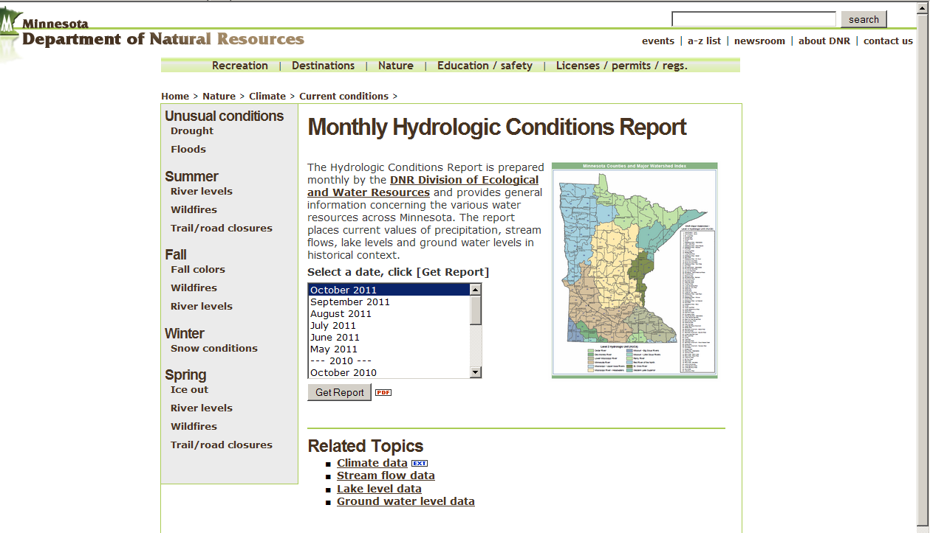
Monthly Hydrologic Conditions Report: http://www.dnr.state.mn.us/current_conditions/hydro_conditions.html

